Slide 1


Horace Mann Partnership - Student Loan Forgiveness
Mike Roman, Local Representative
Dennis Novak, Local Representative
Julie Kudrna, Local Representative

Slide 2

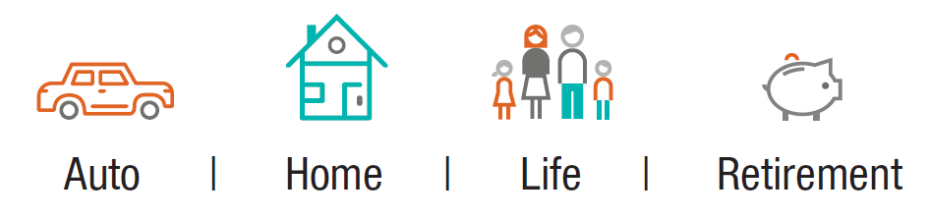
What we believe
Educators are taking care of our children’s future, and we believe they deserve someone to look after theirs.
Notes:
Our company and our agents have a unique perspective on the educational community. Horace Mann was founded by two Springfield, Illinois, educators more than 70 years ago, and we’ve been helping educators achieve financial success ever since.
At the heart of our company is the belief that we’re here for educators. Much like educators are busy helping their students prepare for their futures, we are here to help them identify their financial goals and build a plan to achieve them.
We partner with more than 4,000 school districts nationwide to provide financial solutions for educators.

Slide 3

What Makes Horace Mann Special for Schools
  Our History – Founded by two Springfield teachers in 1945
  Our Commitment
    Helping school employees understand their retirement options
    Presenting educational workshops to inform school employees of issues impacting their financial futures
    Offering 403(b)s to educators since Congress enacted legislation in 1961
    Providing products, features and services developed specifically for school employees
  Our Partnerships
    Aligned with educational associations throughout the country
    Committed partner for our schools and our teachers
      DonorsChoose.org funding for classroom supplies
      Teacher and staff recognition programs
Notes:
Horace Mann was founded by two teachers for educators 70 years ago.
We were one of the 1st 403(b) providers for school districts in 1961.
Forbes has listed HM as a Trustworthy company for the last two years because of our sound fiscal management. We will be here when you most need us.

Slide 4
Educators look out for their students’ futures.
They deserve someone to look out for theirs.
Professional dedication
Spend 52 hours a week doing school-related activities
Supplement budget with their own money
27% spend more than $400 annually
99% participated in professional development in the past year
18%: Wanted to help children
Have a passion for what they do
34% became a teacher because they have a passion for teaching
30% spend between $200-$400
Only 5% spend no personal money for their classroom
14%: “I believe I can make a difference”
48% have a masters degree
Sources: Horace Mann Educator Advisory Panel survey, May 2014; National Center for Education Statistics Characteristics of Public and Private Elementary and Secondary School Teachers in the United States, August 2013; Horace Mann Educator Advisory Panel survey, May 2015.
Notes:
Teachers are dedicated to their profession.
We know this through our own educator surveys and those of others.
We need to make sure they are investing in their own financial futures so they’ll continue to be there to invest in their students’ futures.

Slide 5

What we do…
We connect educators with solutions for:
Managing student loan debt
Retirement preparation
Out-of-pocket classroom spending
Insurance protection
Auto – Home – Life
Notes:
Read from slide
Today we’re going to discuss solutions for managing student loan debt.

Slide 6
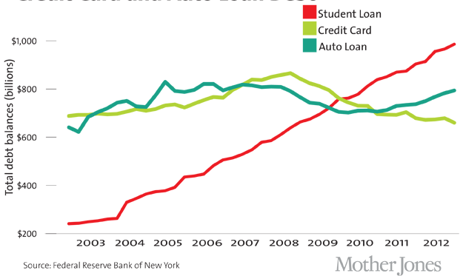
Educator issue: Student loan debt is mounting
College debt causing Millennials to delay life milestones
Question career choice
Ability to save for the future
More dependent on parents and family
Delaying marriage and home buying
Interest on outstanding debt of $1.4T at 6.58% represents $78B in lost savings
Student loan debt has surpassed both credit card and auto loan debt
15% of student loans default
Average student loan debt for a 2017 graduate is $38,000
$1.2 trillion in student debt outstanding nationwide
Source: https://www.debt.org/students/ and Horace Mann calculations
6
Notes:
Average student loan debt from 2014 is more than $30,000 (debt.org)
What does the debt do to the young person?
Pressure to make money – get a job and get a job that pays enough to handle the cost
Potential impact to you –challenges retaining new teachers as they adjust to the teaching profession, they are determining if it pays enough.
2) Stress of preparing for retirement – millennials are talking about retirement planning and are concerned about planning BUT debt is an obstacle to actually doing something about it.
3) Impact on the parents– (insert personal experience in raising your daughters)
Graduating and moving back home – likely not paying rent
Mom and Dad are frequently paying some of the bills – cell phone, groceries
Staying on their parents car insurance
Student loans are virtually unforgivable – not for bankruptcy or at death – so smart parents are carrying a term life insurance policy on their young adult to cover that student loan debt.
4) The “delay” – millennials are marrying and starting families later, buying homes later.
What does that mean to you? Back to the challenge of retaining new teachers – once they put down roots in the community, you have a better chance to keep them.

Slide 7
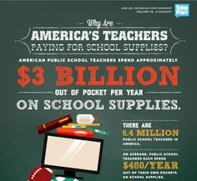
Educator issue: Teachers spend $500 a year on supplies
If teachers invested that $500 a year at 6% over 30 years, it could translate into roughly $126 billion in savings, or $40,000 in additional retirement savings per teacher.
92 percent of teachers spend their own money on classroom supplies
85 percent of teachers buy instructional materials for their students
Average spend is $500 per teacher per year, which adds up to $1.6B total
*Sources: 2013 NSSEA Retail Market Awareness Study, Horace Mann calculations
7
Notes:
Surveys have shown that teachers spend a lot of their own money, some $500 a year.
By providing them with other sources for that funding (such as DonorsChoose.org), they can save that money and make it work toward their financial security.

Slide 8
Pop Quiz!
What percentage of teachers in your building have student loans? Do you know how much total debt they have?
Do younger or older educators have more student loan debt?
Do you have student loan debt you are still paying on? Do these forgiveness programs apply to you as an administrator?
On average, how much money do your teacher’s spend on their classroom each year?
Have you turned a teacher‘s project idea down this year due to budget issues?
Do you feel that all your employees are properly prepared for retirement? Honestly.
Sources: U.S. Federal Reserve, Edvisors, National Education Association, Horace Mann Educator Advisory Panel, June 2015.
Notes:
Read from slide

Slide 9

Student Loan Solutions
Line 1 copy here
line 2 copy here
line 3 copy here
Firstname Lastname
00/00/00
PPT-00163 (11-17)

Slide 10
Managing Student Loan Debt
$1.4 Trillion
$37,700
71%
Student loan debt averages more than $37,000 —
which can be more than a full year’s salary for a new teacher ($36,141)
71% of educators agree: “For many young teachers today, student loan debt is the difference between wanting to continue to teach and wanting to change career paths to a career that pays better.”
Student loan debt nationwide tops $1.4 trillion — more than credit card debt or auto loans
Sources: U.S. Federal Reserve, Advisors, National Education Association, Horace Mann Educator Advisory Panel, Nov. 2017.
Notes:
Review slide.

Slide 11
We can help: Student Loan Solutions
Remove
Reduce
Redirect
Under certain conditions, student loan debt can be forgiven
Repayment & refinancing options may help lower payments
Any savings can be redirected toward other financial goals
Horace Mann has a suite of solutions to help you manage student loan debt and help you get on the road to financial success.
Notes:
Highlight the 3 Rs – remove, reduce, redirect.
Review slide.

Slide 12
Teacher Loan Forgiveness Program
Designed for current and former classroom teachers
  Qualifications
    Must teach five consecutive years in a qualifying low income school
    Must be a new borrower after Oct. 1, 1998
Remove
  Qualifying loans
    Subsidized and Unsubsidized Stafford Loans
    Federal Family Education Program Loans (FFEL)
    Direct Subsidized Loans
    Direct Unsubsidized Loans
  Forgiveness amount = $5,000 for most teachers
  Up to $17,500 for:
          Special Education teachers (any grade)
          Highly qualified Secondary* math & science teachers (*Definition of ‘secondary’ varies by state)
Source: Federal Student Aid
Notes:
Review slide.

Slide 13




Public Service Loan Forgiveness (PSLF)
This program is available to all full-time public service employees
After program completion, the amount forgiven = remaining loan balance
120 qualifying
payments…
…in qualifying
repayment plans…
…and apply for PSLF.
Start
Remove
…while working for a qualifying employer…
…on Direct Loans…
Source: Federal Student Aid
Notes:
Review slide.

Slide 14

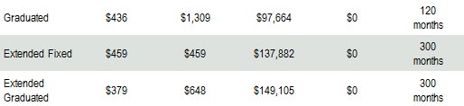
What is your current repayment plan?
You may be making larger payments than you need to be
Standard, 10-year level payments are the typical default payment plan for your student loan
Reduce
Larger payments!
Your loan servicer will likely offer you a non-qualifying plan (below) when you call for help
Do not qualify for PSLF!
Your current payment plan may not even qualify for
Public Service Loan Forgiveness (PSLF)!
Source: https://studentloans.gov/myDirectLoan/repaymentEstimator.action
Assumes $36,000 in annual income, interest rate of 6.8%, household size of 1 and $60,000 in student loan debt
Notes:
Review slide.

Slide 15
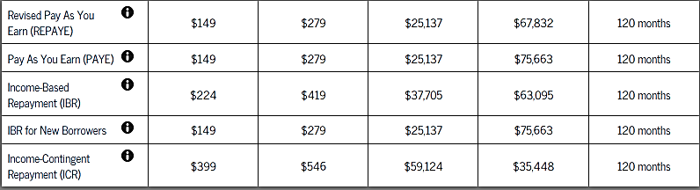
Repayment plans based on income
Income-driven repayment options may reduce monthly payments and make them more manageable.
Reduce
Larger payments!
Income-Driven Repayment Plans qualify for Public Service Loan Forgiveness (PSLF)!
Qualify for PSLF!
Generally, when you make lower payments or extend your repayment period, you will owe more in interest over time – but if you receive PSLF it will be forgiven!
Source: https://studentloans.gov/myDirectLoan/repaymentEstimator.action
Assumes $36,000 in annual income, interest rate of 6.8%, household size of 1 and $60,000 in student loan debt
Notes:
Review the slide.

Slide 16
See how it works…
$88,000 in debt eliminated and approximately $20,000 in retirement savings gained
Meet Kate
Reduce Loan Payments
403(b) Investments
Retention & Confidence
Financial Success
Meet
Kate
Age: 24 AGI: $30,000
Beginning Student Loan Debt Total: $50,000
Monthly Payments: $347/mo for 300 months
Retirement Savings: $0/mo
Income-based Repayments
Old Loan Payment: $347/mo
New Loan Payment: $99/mo
Save for
the future
Old Investment/mo: $0
New Investment/mo: $100/mo
Adjusted Loan Payment:
$89/mo
Continue
teaching
Continue teaching:
10 years while
making 120 payments
Continue investing: $100+5% annually
Submit PSLF eligibility form
Goals
achieved
Age: 34
Debt eliminated:
$88,000+
Total saved for retirement:
Approximately $20,000+
403(b) investments assume 5% annual earnings and no withdrawals. Debt eliminated includes interest.
Results are hypothetical for illustrative purposes only and do not reflect the performance of any specific investment.
Notes:
Review slide.
In this scenario, as your Adjusted Gross Income (AGI) increases, your income-driven student loan payment will increase proportionally. Income driven payments may increase or decrease depending on your individual household statistics, including your AGI. 403(b) contributions reduce your AGI. This means that you may offset your salary increases and keep your payments level by increasing your 403(b) contributions.
(Note to speaker: Reference - https://studentloans.gov/myDirectLoan/repaymentEstimator.action#. Scenario is hypothetical and is based on a total loan amount of $50,000, a qualifying Federal Direct loan with an interest rate of 6.8%, an initial Adjusted Gross Income of $30,000, a Household size of 1. It also assumes completion of the PSLF program.)

Slide 17


Refinancing may be the right option
  Citizens One Education Refinance Loan® customers saved an average of $137/month¹
PREMOVE
PREDUCE
PREDIRECT
  Potential to lower your interest rate²
  Potential to lower your monthly payment²
  Potential to increase monthly cash flow to redirect to retirement²
1. Average savings based on 33,437 actual customers who refinanced their federal and private student loans through Citizens One between January 6, 2014 and March 31, 2016. The borrower’s savings might vary based on the interest rates, balances and remaining repayment term of the loans they are seeking to refinance. The borrower’s overall repayment amount may be higher than the loans they are refinancing even if their monthly payments are lower. Refinancing provided by Citizens One. Refinancing a federal student loan will make borrower ineligible for loan forgiveness programs, could lengthen the repayment period of the loan, and would waive any current and future benefits of the program. 2. For eligible applicants of Citizens One Education Refinance Loans. For information on eligibility requirements go to https://studentloans.citizensone.com/lr/ERL?HoraceMann. Citizens One is a brand name of Citizens Bank, N.A. and Citizens Bank of Pennsylvania. Member FDIC.
Horace Mann receives compensation from Citizens One for each loan funded through this program. Horace Mann and Citizens One are unaffiliated.
Notes:
You may also be able to reduce your monthly payments by refinancing. Horace Mann has a relationship with Citizens One to refinance existing student loans with competitive interest rates.
Why refinance?
Average customer savings $137/month
Potential to lower your interest rate
Potential to lower your monthly payment
Potential to increase monthly cash flow to redirect to retirement
Refinancing a federal student loan will make borrower ineligible for loan forgiveness programs and could lengthen the repayment period of the loan.

Slide 18
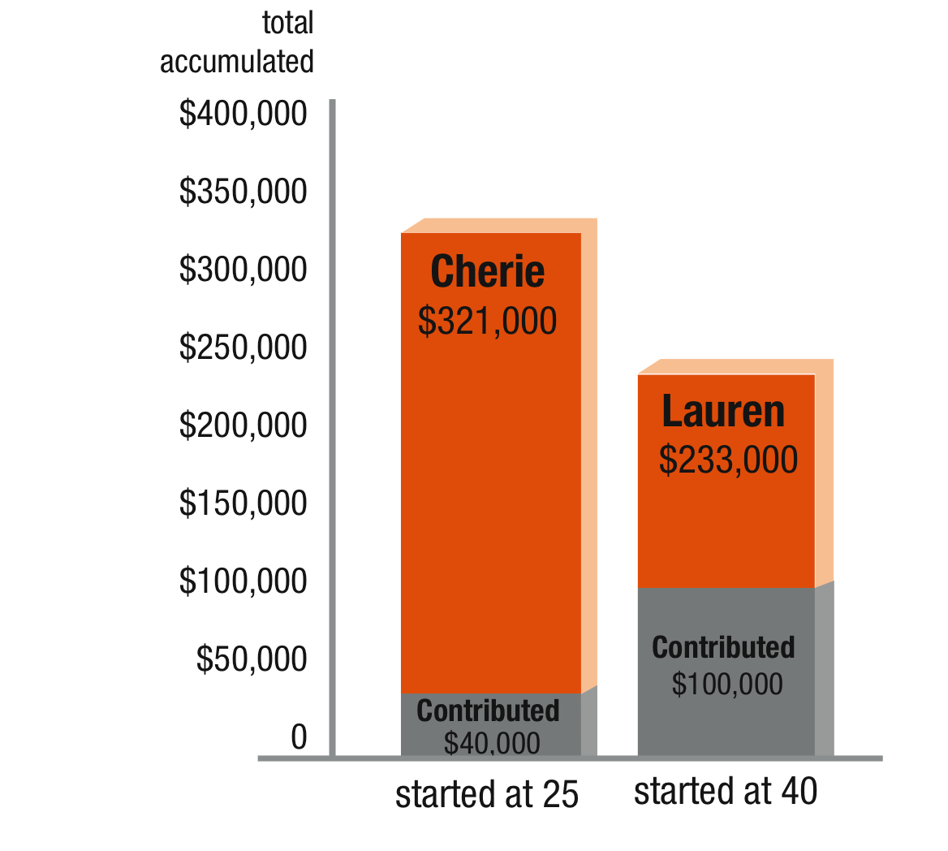
The power of starting early
PREMOVE
PREDUCE
PREDIRECT
Cherie
  Started a retirement fund at age 25
  Contributed $4,000 annually for 10 years for a total of $40,000
  Earned 6% annually
Lauren
  Started a retirement fund at age 40
  Contributed $4,000 annually for 25 years for a total of $100,000
  Earned 6% annually
Assumes 6% annual earnings and no withdrawals. Results are hypothetical for illustrative purposes only and do not reflect the performance of any specific investment.
Notes:
Let’s look at the scenario above. Cherie starts a retirement fund at 25, contributes $4,000 a year, and stops after 10 years.
Lauren waits until she’s 40 to start contributing, also contributes $4,000 and does it for 25 years (that’s 15 years longer than Cherie). Both have the same annual earnings of 6%.
So, even though Cherie only contributed $40,000 while Lauren contributed $100, 000 – Cherie still ends up with more than Lauren at age 65. She has $321,000 to Lauren’s $233,000.
The secret is time and the compounding returns that accompany it. The longer you delay, the less time your money can accumulate.
These figures are hypothetical and do not represent the returns for any particular investment. The figures do not take taxes, account fees, or inflation into account.

Slide 19

How to use DonorsChoose.org and get the classroom supplies you need
Presented by
The Horace Mann Companies
Notes:
Talking points:
Good morning! I want to thank you for coming, and I want to thank Principal (X) for allowing me to be here with you today. Let me introduce myself, my name is (XXXXXX) and I represent Horace Mann.
Has anyone heard of Horace Mann the company before?
How about Horace Mann the person, who was he? That’s right! Horace Mann was the father of public education. And there is a reason my company chose that name, and that is because we are a company founded by educators, for educators. In 1945, two high school teachers in Springfield, IL started an insurance company for their colleagues. They thought that as a whole, teachers were a safer class of drivers, and therefore should receive discounts on their auto insurance. Over the next 71 years, we grew to become the largest multiline insurance company focusing specifically on educators. We now offer auto, home, life insurance and retirement solutions.
But there are two sides to Horace Mann, our business side which we just talked about, and our partnership side, which is what I want to talk to you about today. We understand how important the responsibility you have is to our community. So we want to give back to you and say thank you for what you do. We partner with schools to provide teacher appreciation events, lunches for faculty in service days, you name it and we are willing to consider a partnership to give back to you.
We also hold workshops on student loan forgiveness, who has student loan debt in the room today? Most of us, well that is something we can work with you to help reduce your payments and have a good portion of that debt forgiven.
We also provide workshops on your retirement system to help you better understand what you will need in retirement and how to plan for that day.
The other workshop we present is the one I am here to introduce to you today, and that is Donorschoose.org. Has anyone heard of Donorschoose.org? What is it? Right! Donorschoose.org is a non-profit organization that helps teachers in need of classroom supplies get the funding necessary to provide those supplies to their students. This is one of our favorite partnerships with schools because it is a way for you to get the materials you need for your classroom without spending money out of your own pocket.

Slide 20

Our commitment to education – DonorsChoose.org
Educators have one of the most important jobs there is – shaping children’s futures. But with school budgets constantly dwindling, their job becomes more and more challenging. Horace Mann and DonorsChoose.org want to help
Horace Mann and our agents have donated more than $3 million*
DonorsChoose.org projects funded in Missouri schools in 2015
  1941 projects funded
  1166 teachers supported
  153,901 students impacted
  $1,075,360 Total donations
In our DonorsChoose.org workshop educators will learn:
  What is DonorsChoose?
  How does it work? How can I submit a project?
  Tips on how to submit projects that get successfully funded
  Tips on how to leverage the power of social media to fund projects.
*From Feb. 2011 – Dec. 2015

Slide 21
Does it work? Yes!
Since 2000, DonorsChoose.org has enabled the funding of more than 560,000 classroom projects benefiting more than 14.0 million students.
These projects have brought over $500 million in resources to public school classrooms.
On average, 70% of projects posted to DonorsChoose.org are funded!
In MO,
  2012 – 250K
  2013 – 500K
  2014 – 800K
  2015 – 1.1 Million
  2016 – 2.1 Million
  2017 – 2.3 Million
  2018 – 2.9 Million
  2019 – 3.0 Million

Slide 22
How do I get my project funded?
Send a note or an email to your student’s parents, grandparents, relatives
Post your project on social media
Get the community involved – Use local business resources to build interest and funding for your project
Get your local coffee shop to post your project on the bulletin board or chalk board
Get parent organizations involved – Local PTA, Booster
Tap into community organizations – Kiwanis, Lions Club, Rotary
Notes:
Talking points - Here’s how you help them utilize other means to get funding.

Slide 23
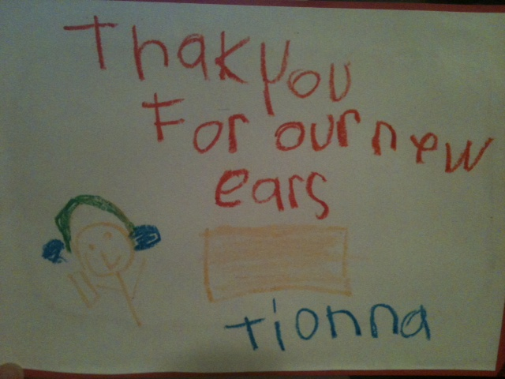
DonorsChoose.org helps students in your area
Notes:
This page is for you to show samples (pictures, etc.) of fully funded projects in your area. You can save any photos off the DonorsChoose.org website and insert in your powerpoint. To save off the website, find the photo you want and right click to save to your computer. To insert photo into power point, click the icon in the picture box and select your photo. Once your photo is chosen, click on it, click on “Picture Tools”, “Format” and find the “Rotated White” option. Size the photo by dragging the corners to fit on the slide. There is also an area to insert text about the project you have funded.

Slide 24

The Retirement Puzzle
Make sure you have all the pieces
Public School Retirement System of Missouri (PSRS)
SPS-sem0207MO
080115
Notes:
Good afternoon.
My name is ________ and I am with The Horace Mann Companies. Our Company was named one of Forbes Most Trustworthy Companies in 2013 and 2014. The first thing I want to do today is put your mind at ease. I know what some of you are thinking – “ he/she is from an insurance company and his/her main objective is to sell me something.” Well, let me assure you that is not why I am here, although it would be nice if each of you were a Horace Mann client.
I am here today to talk to you about your state retirement program and a little about the retirement planning process. I hope you leave here today with a better understanding of how your state retirement program works.

Slide 25
Public School Retirement System of Missouri (PSRS)
Membership
Contributions
Vesting
Benefit factors
Beneficiary
Survivor benefits
Payment plans
Service retirement
Early retirement
COLA
Notes:
We are going to cover a lot of things today and show you how a benefit is calculated. Unfortunately, we don’t have time today to go into detail on each of these topics, but we will discuss most of them.
This information is from the Member Handbook and the PSRS Web site.

Slide 26
Your beneficiary
Make a beneficiary designation
  One or more primary beneficiaries
  One or more contingent beneficiaries
Keep your designations up to date
“Nomination of Beneficiary” form
Notes:
How many of you know who the beneficiary of your PSRS account is? (Ask for a show of hands)
If you raised your hand, please double check to be sure. There are so many different places that you have to list a beneficiary that a lot of times people forget who is listed on what. Your beneficiary designation is shown on your annual statement and in the secure portion of the PSRS Web site.
Before retirement you can name one or more persons, your estate, a trust, institutions, a charity or any combination as beneficiary. If your personal situation changes – for example if you get married or your beneficiary dies – you should review your designations and make any necessary changes.
Agent note: If you are using the packaged kit, refer to the beneficiary form that’s included. Review the form before the presentation. In some states a spouse’s consent/signature is required, if the spouse is not the beneficiary.

Slide 27
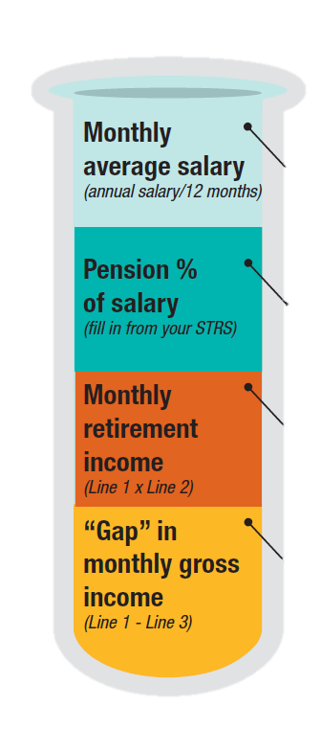
Service retirement
$4,167
Assumptions
Member – age 60
Beneficiary – age 60
Service – 30 years
FAS – $50,000
(2.5% x 30)
$3,125
$1,042
This example is for illustration only. Figures using your specific information can be obtained by going to the PSRS website.
Notes:
Here is an example of the single life option for an individual who qualifies for unreduced benefits.
We have a 60-year-old member, 30 years of creditable service, and final average salary of $50,000, which is $4,167 per month. This formula comes from the state and we are going to simply plug the numbers in.
FAS of $4,167times .025 times 30 years equals a monthly benefit of $3,125. Multiply that by 12 to get an annual benefit of $37,500.
Notice the sizeable gap in gross income of $1,042 per month.

Slide 28
Payment options
Option | Retiree | Beneficiary
1 – Single life | $3,125 | ?
2 – Joint & 100% | $2,801 | $2,801
3 – Joint & 75% | $2,876 | $2,157
4 – Joint & 50% | $2,954 | $1,477
5 – 120 month term | $3,070 | $3,070 or $0
6 – 60 month term | $3,111 | $3,111 or $0
FAS = $4,167
Notes:
Using the same example, here are payment options that would provide for a beneficiary who is also age 60. There are two types of benefit payment plans – single life plans and joint and survivor plans. All payment options provide monthly benefits as long as you live.

Slide 29
You should review your retirement plan
Retirement planning
is a process,
not an event!
Notes:
And finally, review your retirement plan at least once a year. Retirement planning is a process, not an event!
What you did as far as retirement planning 10 years ago, 5 years ago, or maybe even last year may not still be the best option for you now – periodic review is one of the most important steps in the planning process.
Thank you for attending this session. I hope you have learned more about your state retirement program. If you would like to meet individually about your retirement needs, please complete the interest card and let me know the best way to contact you.
[END OF PRESENTATION]
Note: The presentation continues with three OPTIONAL slides.

Slide 30


We maintain strong national and state association relationships
Strategic partner with the Association of School Business Officials International (ASBO)
Proud sponsor of ASBO International’s Certified
Administrator of School Finance & Operations program
State relationships include all state and regional ASBO affiliates.
Participate at The School Superintendents Association (AASA), National Association of Secondary School Principals (NASSP) and National Association of Elementary School Principals (NAESP) annual conventions.
Notes:
We maintain strong national and state association relationships.
We’re a strategic partner and active leader with the Association of School Business Officials International (ASBO);
Proud sponsor of the ASBO International’s Certified Administrator of School Finance and Operations program, a mark of professional excellence in school businesses.
We also participate at The School Superintendents Association (AASA), National Association of Secondary School Principals (NASSP) and National Association of Elementary School Principals (NAESP) annual conventions.
Our state relationships include:
XXXXXX

Slide 31
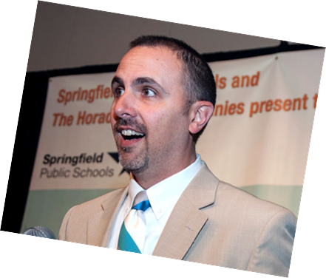

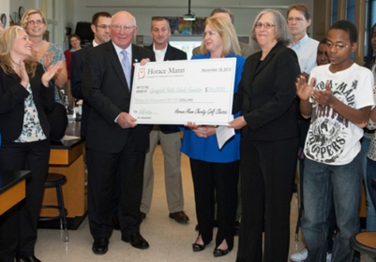



Leveraging Local Partners
Leveraging local partners to facilitate the success of students, teachers, employees and the school district.
Teacher Appreciation
Classroom
Supplies
Student Recognition

Slide 32


What’s next?
Schedule an appointment to find the solution that’s right for you.
Mike Roman
314-575-6220
Mike.roman@horacemann.com
Dennis Novak
636-368-1037
Dennis.novak@horacemann.com
Julie Kudrna
417-849-1627
Julie.kudrna@horacemann.com
Notes:
Schedule an appointment to find the solution that’s best for you and your situation.

Slide 33
Thank you for coming!

