Slide 1
Missouri Association of Elementary School Principals Fall Executive Committee Meeting Agenda Thursday, September 28, 2023
MCSA Offices 3550 Amazonas Dr. Jefferson City, MO
9:30 a.m.
1.
Registration of Proxies
2.
Call to Order – Dr. Crystal Magers, MAESP President
a)
b)
c)
d)
President’s welcome
Consideration of the Consent Items and Minutes Call for additional items
Approve agenda
Remarks Action Discussion Action
3.
Board Member Check-In - Regional Representatives and Presidents
a) Brief overview of MCSA, MAESP structure
MAESP Financial Report – Dr. J Anderson, Executive Director
4.
a)
b)
c)
d)
FY2022-2023 EOY Financial Statement FY2022-23 Audit
FY2023-24 Budget
Current Financial Statement
Action Update/Action Action
Action
5.
Executive Director Report – Dr. J Anderson, Executive Director
a)
b)
c)
d)
e)
f)
Membership Update
Professional Development Programming (MLDS) Update – Micro-credentials
Executive Coaching Commissioner Advisory
Filing Deadline – December 1, 2023 Candidates for: President-elect, Vice President
Information Information Information
Information Information Information
6.
MAESP Leadership Conference – Dr. Ryan Link, President-Elect Discussion
a)
Key Information for 2024
Theme – Leaders of Hope: Inspire. Believe. Lead.
Keynote Speakers – Emeka Nnaka, Thomas C. Murray, Jessica Cabeen Call for presentations

Slide 2
b)
c)
Current Registrations Concurrent Sessions – topics Social Events
Exhibit Hall
7.
NAESP Report – Dr. Jenni Hayes, NAESP Representative
a)
b)
c)
d)
National Principals Month – October Updated NAESP NDP Criteria and Dates
Zone 8 Leadership Meeting – Nov 17-18 Sante Fe, NM 2024 NAESP Annual Conference – Nashville, TN
Information Discussion Information Information
8.
Proposed Principal Evaluation from DESE
Discussion
9.
Breakouts:
Discussion
Regional Presidents – Calibration of Practices
Regional Reps – Platform option, Assoc Feedback
10.
Adjournment
Action

Slide 3
Missouri Association of Elementary School Principals Financial Statement
June 30, 2023
Beginning Balance July 1, 2022 | $1,078,455.44
AssetMark | -$6,845.08
Receipts | $880,650.83
Expenditures | $730,593.09
Balance June 30, 2023 | $1,221,668.10
`

Slide 4
Reconciliation Statement
Missouri Association of Elementary School Principals
May 31, 2023
Checking/Sweep Account (0.06% weighted average interest rate)
Bank Balance
Outstanding Checks
Outstanding Deposits
Ending Balance April 30, 2023
$454,343.95
$9,600.00
$0.00
$444,743.95
Prime Advantage Account No. 000485052 (0.05% rate of interest)
Bank Balance 5/31/2023 | $1,502.66
Interest | $0.06
Transferred to Checking Account
Ending Balance June 30, 2023 | $1,502.72
Above accounts are held at Jefferson Bank, 700 Southwest Blvd., Jefferson City, MO month CD (.60% interest rate) Bank Balance 1/10/2023 $259,280.45 Interest $1,917.96 Ending Balance April 10, 2023 $261,198.41 Above CD is held at First State Community Bank, 300 Diego Dr., Columbia, MO month CD (3.00% interest rate) Matures December 2023 Beginning Balance October 15, 2022 $225,000.00 Interest $1,820.46 Ending Balance January 31, 2023 $226,820.46 Above CD is held at First Midwest PO Box 160, Poplar Bluff, MO 63902 AssetMark Beginning Balance Current Value Transfer from checking March 11, 2021 $300,000.00 Ending Balance April 30, 2023 $266,862.36
MAESP District Accounts | $18,802.23
Ending Balance June 30, 2023 | $1,219,930.13
Total all accounts - June 30, 2022 | $1,078,280.44

Slide 5
Missouri Association of Elementary School Principals Budget Summary June 30, 2023
Receipts | Budget | Carried Over | 2022-2023 YTD |  | 2021-2022 End of Year
MAESP Membership Dues | $276,000.00 | $43,969.00 | $312,422.50 |  | $292,317.50
Designated for next year |  |  | $65,131.00 |  | $43,969.00
MAESP District Membership | $10,000.00 | $2,845.00 | $20,945.00 |  | $14,743.53
Designated for next year |  |  | $3,765.00 |  | $2,845.00
NAESP Membership Dues | $85,000.00 | $12,703.00 | $105,669.00 |  | $89,285.00
Designated for next year | $0.00 |  | $20,758.00 |  | $12,703.00
NAESP Processing Rebate | $4,000.00 |  | $6,048.00 |  | $4,468.00
Aspiring Principal Workshops | $4,000.00 |  | $7,028.00 |  | $6,300.00
Beginning Teachers Conference | $1,000.00 |  | $0.00 |  | $1,382.28
Educational Office Personnel Conference (EOP | $30,000.00 | $25,868.00 | $34,583.00 |  | $31,664.00
Designated for next year | $0.00 |  | $28,992.00 |  | $25,669.00
Leadership Conference | $200,000.00 | $16,029.00 | $263,582.00 |  | $238,767.00
Designated for next year | $0.00 |  | $17,617.00 |  | $16,079.00
New Principals Conference | $10,500.00 | $9,168.00 | $12,358.00 |  | $21,485.88
Designated for next year |  |  | $17,430.00 |  | $9,168.00
Professional Development Workshops | $19,000.00 |  | $16,984.59 |  | $19,338.00
Designated for next year |  |  | $0.00 |  | $0.00
Building Rent | $12,000.00 |  | $12,000.00 |  | $12,000.00
Investment Interest | $1,000.00 |  | $8,555.38 |  | $1,234.07
Special Initiative Microcredentia |  |  | $2,876.81
Miscellaneous |  |  | $817.55
Principal Support (MC's, Coaching, ELN, etc) | $38,425.00 |  | $25,000.00 |  | $1,065.18
Publications | $2,500.00 |  | $2,085.00 |  | $2,405.00
Public Relations | $4,000.00 |  | $6,585.00 |  | $5,075.00
Carry-Over Funds | $48,000.00 |  | $0.00 |  | $0.00
Total Receipts | $745,425.00 | $110,582.00 | $991,232.83 |  | $851,963.44
Expenditures | Budget |  | 2022-2023 YTD
Membership District Dues | $10,000.00 |  | $15,274.77
NAESP Dues | $85,000.00 |  | $106,716.00
NAESP Meetings | $18,000.00 |  | $24,562.71
Executive Director Expenses | $4,000.00 |  | $6,230.57
MCSA Administrative Services | $75,000.00 |  | $73,521.54
MCSA Umbrella | $264,000.00 |  | $265,862.17
Contingency | $28,000.00 |  | $0.00
Contingency Travel | $7,000.00 |  | $0.00
Aspiring Principal Workshops | $1,000.00 |  | $1,154.20
Beginning Teachers Conference | $200.00 |  | $0.00
Educational Office Personnel Conference | $19,000.00 |  | $20,150.33
Leadership Conference | $100,000.00 |  | $122,890.89
New Principals Conference | $5,000.00 |  | $3,880.49
Professional Development Workshops/Offerings | $9,000.00 |  | $8,772.28
Legal Assistance | $3,000.00 |  | $2,250.00
Publications | $10,000.00 |  | $8,952.63
Member Benefits (Marshall Memo, ELN) | $8,000.00 |  | $2,500.00
Principal Support - MC's & Exec Coaching | $38,125.00 |  | $9,136.54
Executive Committee | $1,000.00 |  | $1,263.60
Legislative Committee | $200.00 |  | $250.50
Public Relations Committee | $1,400.00 |  | $863.73
School Administrators Coalition | $17,000.00 |  | $17,000.00
MO Education Roundtable | $1,000.00 |  | $1,000.00
Audit | $6,000.00 |  | $6,000.00
Bank Fees | $14,000.00 |  | $15,803.30
Capital Outlay | $0.00 |  | $0.00
Contingency | $7,000.00 |  | $0.00
Insurance - Officers Liability | $2,000.00 |  | $1,425.00
Miscellaneous | $2,000.00 |  | $5,350.23
Postage/Printing | $1,500.00 |  | $2,110.91
Supplies/Services | $8,000.00 |  | $7,670.70
Transfer |  |  | $0.00
Total Expenditures | $745,425.00 |  | $730,593.09
2021-2022 End of Year
$11,846.31
$88,135.00
$20,378.77
$1,147.45
$58,723.71
$250,998.01
$0.00
$0.00
$634.35
$0.00
$18,555.00
$111,856.02
$13,031.65
$10,219.18
$750.00
$8,093.84
$9,194.00
$0.00
$0.00
$0.00
$1,400.00
$17,000.00
$0.00
$5,000.00
$13,952.28
$0.00
$0.00
$1,425.00
$1,363.41
$2,381.57
$9,182.07
$655,267.62

Slide 6
Missouri Association of Elementary School Principals
2023-2024 Budget
 | Revenues | Budget
Memberships
 | MAESP Membership Dues | $ 285,000.00
 | Designated for Next Year | $ -
 | NAESP Rebate | $ 4,000.00
 | MAESP District Dues* | $ 15,000.00
 | Designated for Next Year | $ -
 | NAESP Membership Dues* | $ 85,000.00
 | Designated for Next Year | $ -
 |  | $ 389,000.00
Conferences/Workshops
 | Aspiring Principals Workshop | $ 5,000.00
 | Educational Office Personnnel Conference (EOP) | $ 30,000.00
 | Designated for Next Year | $ -
 | Leadership Conference | $ 225,000.00
 | Designated for Next Year | $ -
 | New Principals' Conference | $ 18,000.00
 | Designated for Next Year | $ -
 | Womens' Leadership Retreat | $ 10,000.00
 | Professional Development Workshops | $ 18,705.00
 |  | $ 306,705.00
Administrative
 | Building Rent | $ 12,000.00
 | AssetMark Value
 | Investment Interest | $ 1,500.00
 | ELN (Micro Credentials)
 | Miscellaneous
 | Principal Support (Exec Coaching)* | $ 38,425.00
 | Publications | $ 2,500.00
 | Public Relations | $ 4,000.00
 |  | $ 58,425.00
 | Total | $ 754,130.00

Slide 7
Missouri Association of Elementary School Principals
2023-2024 Budget
 | Expenditures | Budget
Memberships
 | MAESP District Dues* | $ 15,000.00
 | NAESP Membership Dues* | $ 85,000.00
 | Principal Support (Exec Coaching)* | $ 38,425.00
 | Member Benefits (Marshall Memo/ELN) | $ 10,000.00
 | Publications | $ 10,000.00
Conferences/Workshops
 | Aspiring Principals Workshop | $ 1,000.00
 | Educational Office Personnnel Conference (EOP) | $ 21,000.00
 | Leadership Conference | $ 120,000.00
 | New Principals' Conference | $ 10,000.00
 | Womens' Leadership Retreat | $ 10,000.00
 | Professional Development Workshops | $ 10,000.00
Administrative
 | MCSA Umbrella | $ 226,740.00
 | MCSA Administrative Services | $ 78,465.00
 | NAESP Business | $ 30,000.00
 | Executive Director Expenses | $ 8,000.00
 | Administrative Contingency | $ 12,000.00
 | Administrative Travel | $ 5,000.00
 | Executive Committee | $ 1,500.00
 | Legislative Committee | $ 500.00
 | Public Relations Committee | $ 1,400.00
 | Legal Assistance | $ 3,000.00
 | School Administration Coalition | $ 17,000.00
 | MO Education Roundtable | $ 1,000.00
 | Audit | $ 6,600.00
 | Bank Fees | $ 14,000.00
 | Capital Outlay Contingency | $ 5,000.00
 | Insurance - Officers' Liability | $ 1,500.00
 | Miscellaneous | $ 2,000.00
 | Postage/Printing | $ 2,000.00
 | Supplies/Services | $ 8,000.00
 | Total | $ 754,130.00

Slide 8
Missouri Association of Elementary School Principals Financial Statement
August 31, 2023
Beginning Balance July 1, 2023 | $ 1,225,897.69
Revenue | $ 228,638.60
Expenditures | $ 95,753.36
Balance August 31, 2023
$ 1,358,782.93

Slide 9
Reconciliation Statement
Missouri Association of Elementary School Principals 31‐Aug‐23
Jefferson Bank of Missouri Checking/Sweep Account (0.06% weighted average interest rate) Bank Balance $ 380,175.76 Outstanding Checks $ 3,306.58 Outstanding Deposits $ ‐
Ending Balance August 31, 2023 | $ 376,869.18
Prime Advantage Account No. 000485052 (0.05% interest rate)
Bank Balance 7/31/2023 | $ 1,502.78
Interest Earned | $ 0.06
Ending Balance August 31, 2023 | $ 1,502.84
12‐month CD No. 000150582 (5.2% interest rate) Maturity Date: 8/16/2024
Bank Balance 8/15/2023 Interest Earned
Ending Balance August 31, 2023
$ 200,000.00
$ ‐
$ 200,000.00
13‐Month CD (.60% interest rate) ‐ First State Community Bank, 300 Diego Dr, Columbia MO Maturity Date: 12/10/2023 10 day grace period Bank Balance 4/10/2023 ‐ (Opening Balance $250,000 4/2018) $ 261,198.41 Interest Earned $ 1,953.62
Ending Balance July 10, 2023 | $ 263,152.03
12‐Month CD (3.10% interest rate) ‐ First Midwest PO Box 160, Poplar Bluff, MO 63902
Maturity Date: November 1, 2023
Beginning Balance | $ 228,595.81
Interest Earned | $ 1,849.56
Ending Balance July 31, 2023 | $ 230,445.37
AssetMark Transfer from checking March 11, 2021 $ 300,000.00 Ending Balance August 31, 2023
 | $ 268,173.19
MAESP District Accounts
Northeast Region ‐ 123189183 | $ 3,708.98
Southeast Region ‐ 123189191 | $ 1,344.49
Jefferson County Region ‐ 123189205 | $ 1,393.51
South Central Region ‐ 123279166 | $ 5,092.12
MAESP Region Network (KC) ‐ 123241177 | $ 7,101.22
MAESP Districts' Total Ending Balance 8/31/2023 |  | $ 18,640.32
MAESP Total All Accounts Ending Balance August 31, 2023 |  | $ 1,358,782.93
MAESP Total All Accounts ‐ August 31, 2022 |  | $ 1,241,701.57

Slide 10
Missouri Association of Elementary School Principals Budget Summary 8/31/2023
Revenues
Budget
Carried Over
2023‐2024
YTD
2022‐2023
End of Year
Memberships
 | MAESP Membership Dues | $ 285,000.00 | $65,131.00 | $ 121,780.00 | $ 268,453.50
 | Designated for Next Year | $ ‐ | $0.00 | $ ‐ | $ 65,131.00
 | NAESP Rebate | $ 4,000.00 | $ ‐ | $ ‐ | $ 6,048.00
 | MAESP District Dues* | $ 15,000.00 | $ 3,765.00 | $ 9,140.00 | $ 18,100.00
 | Designated for Next Year | $ ‐ | $ ‐ | $ ‐ | $ 3,765.00
 | NAESP Membership Dues* | $ 85,000.00 | $ 20,758.00 | $ 48,503.00 | $ 92,966.00
 | Designated for Next Year | $ ‐ | $ ‐ | $ ‐ | $ 20,758.00
 |  | $ 389,000.00 | $89,654.00 | $ 179,423.00 | $ 475,221.50
Conferences/Workshops
 | Aspiring Principals Workshop | $ 5,000.00 | $ ‐ | $ ‐ | $ 7,028.00
 | Educational Office Personnnel Conference (EOP) | $ 30,000.00 | $ 28,992.00 | $ 5,644.00 | $ 8,715.00
 | Designated for Next Year | $ ‐ | $ ‐ | $ ‐ | $ 28,992.00
 | Leadership Conference | $ 225,000.00 | $ 17,617.00 | $ 36,288.00 | $ 247,553.00
 | Designated for Next Year | $ ‐ | $ ‐ | $ ‐ | $ 17,617.00
 | New Principals' Conference | $ 18,000.00 | $ 17,430.00 | $ 549.00 | $ 3,190.00
 | Designated for Next Year | $ ‐ | $ ‐ | $ ‐ | $ 17,430.00
 | Womens' Leadership Retreat | $ 10,000.00 | $ 3,402.00 | $ 3,463.00 | $ 3,402.00
 | Professional Development Workshops | $ 18,705.00 | $ ‐ | $ 1,344.00 | $ 13,582.59
 |  | $ 306,705.00 | $ 67,441.00 | $ 47,288.00 | $ 347,509.59
Administrative
 | Building Rent | $ 12,000.00 |  | $ ‐ | $ 12,000.00
 | AssetMark Value |  |  | $ (2,918.29) | $ (2,615.96)
 | Investment Interest | $ 1,500.00 |  | $ 3,955.89 | $ 8,555.85
 | ELN (Micro Credentials) |  |  | $ 585.00 | $ 2,876.81
 | Miscellaneous |  |  | $ 305.00 | $ 817.55
 | Principal Support (Exec Coaching)* | $ 38,425.00 |  | $ ‐ | $ 25,000.00
 | Publications | $ 2,500.00 |  | $ ‐ | $ 2,085.00
 | Public Relations | $ 4,000.00 | $ ‐ | $ ‐ | $ 6,585.00
 |  | $ 58,425.00 | $ ‐ | $ 1,927.60 | $ 55,304.25
 | Total | $ 754,130.00 | $ 157,095.00 | $ 228,638.60 | $ 878,035.34

Slide 11
Missouri Association of Elementary School Principals Budget Summary 8/31/2023
Expenditures
Budget
Carried Over
2023‐2024
YTD
2022‐2023
End of Year
Memberships
 | MAESP District Dues* | $ 15,000.00 |  | $ 125.00 | $ 15,274.77
 | NAESP Membership Dues* | $ 85,000.00 |  | $ ‐ | $ 106,716.00
 | Principal Support (Exec Coaching)* | $ 38,425.00 |  | $ ‐ | $ 9,136.54
 | Member Benefits (Marshall Memo/ELN) | $ 10,000.00 |  | $ ‐ | $ 2,500.00
 | Publications | $ 10,000.00 |  | $ ‐ | $ 8,952.63
Conferences/Workshops
 | Aspiring Principals Workshop | $ 1,000.00 |  |  | $ 1,154.20
 | Educational Office Personnnel Conference (EOP) | $ 21,000.00 |  | $ 4,189.76 | $ 20,150.33
 | Leadership Conference | $ 120,000.00 |  | $ 200.00 | $ 122,890.89
 | New Principals' Conference | $ 10,000.00 |  | $ 15,063.93 | $ 3,880.49
 | Womens' Leadership Retreat | $ 10,000.00 |  | $ 6,147.93 | $ ‐
 | Professional Development Workshops | $ 10,000.00 |  |  | $ 8,772.28
Administrative
 | MCSA Umbrella | $ 226,740.00 |  | $ 37,789.94 | $ 265,862.17
 | MCSA Administrative Services | $ 78,465.00 |  | $ 13,076.90 | $ 73,521.54
 | NAESP Business | $ 30,000.00 |  | $ 6,763.05 | $ 24,562.71
 | Executive Director Expenses | $ 8,000.00 |  |  | $ 6,230.57
 | Administrative Contingency | $ 12,000.00 |  |  | $ ‐
 | Administrative Travel | $ 5,000.00 |  |  | $ ‐
 | Executive Committee | $ 1,500.00 |  |  | $ 1,263.60
 | Legislative Committee | $ 500.00 |  |  | $ 250.50
 | Public Relations Committee | $ 1,400.00 |  |  | $ 863.73
 | Legal Assistance | $ 3,000.00 |  |  | $ 2,250.00
 | School Administration Coalition | $ 17,000.00 |  |  | $ 17,000.00
 | MO Education Roundtable | $ 1,000.00 |  |  | $ 1,000.00
 | Audit | $ 6,600.00 |  |  | $ 6,000.00
 | Bank Fees | $ 14,000.00 |  | $ 3,284.25 | $ 15,803.30
 | Capital Outlay Contingency | $ 5,000.00 |  |  | $ ‐
 | Insurance ‐ Officers' Liability | $ 1,500.00 |  | $ 1,425.00 | $ 1,425.00
 | Miscellaneous | $ 2,000.00 |  |  | $ 5,350.23
 | Postage/Printing | $ 2,000.00 |  | $ 1,941.00 | $ 2,110.91
 | Supplies/Services | $ 8,000.00 |  | $ 5,746.60 | $ 7,670.70
 | Total = | $ 754,130.00 |  | $ 95,753.36 | $ 730,593.09

Slide 12
Missouri Association of Elementary School Principals 5 Year Budget Summary Comparison
Revenues
2023‐2024
Budget
2022‐2023
End of Year
2021‐2022
End of Year
2020‐2021
End of Year
2019‐2020
End of Year
2018‐2019
End of Year
Memberships
 | MAESP Membership Dues | $ 285,000.00 | $ 268,453.50 | $ 292,317.50 | $ 277,584.50 | $ 285,620.00 | $ 281,184.50
 | Designated for Next Year |  | $ 65,131.00 | $ 43,969.00 | $ 33,020.00 | $ 33,717.00 | $ 45,467.00
 | NAESP Rebate | $ 4,000.00 | $ 6,048.00 | $ 4,468.00 | $ 4,490.00 | $ 4,014.00 | $ 5,440.00
 | MAESP District Dues* | $ 15,000.00 | $ 18,100.00 | $ 14,743.53 | $ 5,630.00 | $ 6,065.00 | $ 16,550.00
 | Designated for Next Year |  | $ 3,765.00 | $ 2,845.00 | $ 1,885.00 | $ 1,930.00 | $ 2,625.00
 | NAESP Membership Dues* | $ 85,000.00 | $ 92,966.00 | $ 89,285.00 | $ 88,450.00 | $ 87,160.00 | $ 77,730.00
 | Designated for Next Year | $ ‐ | $ 20,758.00 | $ 12,703.00 | $ 8,810.00 | $ 10,380.00 | $ 12,465.00
 |  | $ 389,000.00 | $ 475,221.50 | $ 460,331.03 | $ 419,869.50 | $ 428,886.00 | $ 441,461.50
Conferences/Workshops
 | Aspiring Principals Workshop | $ 5,000.00 | $ 7,028.00 | $ 6,300.00 | $ 4,975.00 | $ 1,562.00 | $ 2,700.00
 | Educational Office Personnnel Conference (EOP) | $ 30,000.00 | $ 8,715.00 | $ 31,664.00 | $ 17,528.00 | $ 36,476.00 | $ 37,358.55
 | Designated for Next Year |  | $ 28,992.00 | $ 25,669.00 | $ 24,130.00 | $ 14,637.00 | $ 26,169.00
 | Leadership Conference | $ 225,000.00 | $ 247,553.00 | $ 238,767.00 | $ 146,659.00 | $ 220,574.00 | $ 204,638.00
 |  |  | $ 17,617.00 | $ 16,079.00 | $ 17,192.00 | $ 11,797.00 | $ 7,176.00
 | New Principals' Conference | $ 18,000.00 | $ 3,190.00 | $ 21,485.88 | $ 7,876.00 | $ 11,373.00 | $ 13,764.00
 |  |  | $ 17,430.00 | $ 9,168.00 | $ 13,058.00 | $ 6,403.00 | $ 4,189.00
 | Womens' Leadership Retreat | $ 10,000.00 | $ 3,402.00 | $ ‐ | $ ‐ | $ ‐ | $ ‐
 | Professional Development Workshops | $ 18,705.00 | $ 13,582.59 | $ 20,720.28 | $ 7,816.80 | $ 72,587.15 | $ 71,150.52
 | Designated for Next Year | $ ‐ | $ ‐ | $ ‐ | $ ‐ | $ ‐ | $ 447.00
 |  | $ 306,705.00 | $ 347,509.59 | $ 369,853.16 | $ 239,234.80 | $ 375,409.15 | $ 367,592.07
Administrative
 | Building Rent | $ 12,000.00 | $ 12,000.00 | $ 12,000.00 | $ 12,000.00 | $ 12,000.00 | $ 18,000.00
 | AssetMark Value |  | $ (2,615.96)
 | Investment Interest | $ 1,500.00 | $ 8,555.85 | $ 1,234.07 | $ 4,431.19 | $ 12,296.56 | $ 8,075.36
 | ELN (Micro Credentials) |  | $ 2,876.81 | $ 1,065.18 | $ 488.08 | $ 1,337.94 | $ 1,049.49
 | Miscellaneous |  | $ 817.55 | $ ‐ | $ ‐ | $ ‐ | $ ‐
 | Principal Support (Exec Coaching)* | $ 38,425.00 | $ 25,000.00 | $ ‐ | $ ‐ | $ ‐ | $ ‐
 | Publications | $ 2,500.00 | $ 2,085.00 | $ 2,405.00 | $ 3,995.00 | $ 6,015.00 | $ 4,245.00
 | Public Relations | $ 4,000.00 | $ 6,585.00 | $ 5,075.00 | $ 4,992.00 | $ 5,304.00 | $ 4,230.00
 |  | $ 58,425.00 | $ 55,304.25 | $ 21,779.25 | $ 25,906.27 | $ 36,953.50 | $ 35,599.85
 | Total | $ 754,130.00 | $ 878,035.34 | $ 851,963.44 | $ 685,010.57 | $ 841,248.65 | $ 844,653.42

Slide 13
Missouri Association of Elementary School Principals 5 Year Budget Summary Comparison
Expenditures
2023‐2024
Budget
2022‐2023
End of Year
2021‐2022
End of Year
2020‐2021
End of Year
2019‐2020
End of Year
2018‐2019
End of Year
Memberships
 | MAESP District Dues* | $ 15,000.00 | $ 15,274.77 | $ 11,846.31 | $ 2,285.86 | $ 4,854.29 | $ 15,012.78
 | NAESP Membership Dues* | $ 85,000.00 | $ 106,716.00 | $ 88,135.00 | $ 97,925.00 | $ 77,285.00 | $ 80,016.72
 | Principal Support (Exec Coaching)* | $ 38,425.00 | $ 9,136.54 | $ ‐ | $ ‐ | $ ‐ | $ ‐
 | Member Benefits (Marshall Memo/ELN) | $ 10,000.00 | $ 2,500.00 | $ 9,194.00 | $ 7,528.00 | $ 6,824.00 | $ ‐
 | Publications | $ 10,000.00 | $ 8,952.63 | $ 8,093.84 | $ 8,652.00 | $ 10,980.81 | $ 10,710.97
Conferences/Workshops
 | Aspiring Principals Workshop | $ 1,000.00 | $ 1,154.20 | $ 634.35 | $ ‐ | $ 378.05 | $ 526.09
 | Educational Office Personnnel Conference (EOP) | $ 21,000.00 | $ 20,150.33 | $ 18,555.00 | $ 18,978.79 | $ 18,344.13 | $ 23,965.74
 | Leadership Conference | $ 120,000.00 | $ 122,890.89 | $ 111,856.02 | $ 75,259.71 | $ 98,842.73 | $ 83,981.89
 | New Principals' Conference | $ 10,000.00 | $ 3,880.49 | $ 13,031.65 | $ 2,250.00 | $ 4,014.74 | $ 3,071.28
 | Womens' Leadership Retreat | $ 10,000.00 | $ ‐ | $ ‐ | $ ‐ | $ ‐ | $ ‐
 | Professional Development Workshops | $ 10,000.00 | $ 8,772.28 | $ 10,219.18 | $ 4,358.29 | $ 48,856.46 | $ 60,960.49
Administrative
 | MCSA Umbrella | $ 226,740.00 | $ 265,862.17 | $ 250,998.01 | $ 216,423.51 | $ 242,438.24 | $ 236,986.07
 | MCSA Administrative Services | $ 78,465.00 | $ 73,521.54 | $ 58,723.71 | $ 41,312.42 | $ 57,395.01 | $ 63,907.45
 | NAESP Business | $ 30,000.00 | $ 24,562.71 | $ 20,378.77 | $ 3,394.07 | $ 11,987.48 | $ 18,093.47
 | Executive Director Expenses | $ 8,000.00 | $ 6,230.57 | $ 1,147.45 | $ 1,182.97 | $ 2,342.85 | $ 2,830.54
 | Administrative Contingency | $ 12,000.00 | $ ‐ | $ ‐ | $ ‐ | $ ‐ | $ 9,214.00
 | Administrative Travel | $ 5,000.00 | $ ‐ | $ ‐ | $ ‐ | $ 139.02 | $ 578.74
 | Executive Committee | $ 1,500.00 | $ 1,263.60 | $ ‐ | $ ‐ | $ 1,562.84 | $ 1,208.81
 | Legislative Committee | $ 500.00 | $ 250.50 | $ ‐ | $ ‐ | $ 180.00 | $ 229.25
 | Public Relations Committee | $ 1,400.00 | $ 863.73 | $ 1,400.00 | $ 1,109.68 | $ 1,348.00 | $ 1,200.00
 | Legal Assistance | $ 3,000.00 | $ 2,250.00 | $ 750.00 | $ 597.50 | $ 850.00 | $ 500.00
 | School Administration Coalition | $ 17,000.00 | $ 17,000.00 | $ 17,000.00 | $ 17,000.00 | $ 16,000.00 | $ 16,000.00
 | MO Education Roundtable | $ 1,000.00 | $ 1,000.00 | $ ‐ | $ 1,000.00 | $ 1,000.00 | $ 1,000.00
 | Audit | $ 6,600.00 | $ 6,000.00 | $ 5,000.00 | $ 3,100.00 | $ 2,950.00 | $ 2,800.00
 | Bank Fees | $ 14,000.00 | $ 15,803.30 | $ 13,952.28 | $ 11,244.15 | $ 13,837.67 | $ 12,432.25
 | Better Schools for Missouri | $ ‐ | $ ‐ | $ ‐ | $ 155.25 | $ 1,500.00 | $ 1,500.00
 | Capital Outlay Contingency | $ 5,000.00 | $ ‐ | $ ‐ | $ ‐ | $ ‐ | $ ‐
 | Insurance ‐ Officers' Liability | $ 1,500.00 | $ 1,425.00 | $ 1,425.00 | $ 1,350.00 | $ 1,250.00 | $ 1,250.00
 | Miscellaneous | $ 2,000.00 | $ 5,350.23 | $ 1,363.41 | $ 200.01 | $ 947.85 | $ 304.05
 | Postage/Printing | $ 2,000.00 | $ 2,110.91 | $ 2,381.57 | $ 568.40 | $ 898.67 | $ 4,479.55
 | Supplies/Services | $ 8,000.00 | $ 7,670.70 | $ 9,182.07 | $ 7,481.19 | $ 8,449.45 | $ 1,512.46
 | Total = | $ 754,130.00 | $ 730,593.09 | $ 655,267.62 | $ 523,356.80 | $ 635,457.29 | $ 654,272.60

Slide 14
MAESP MEMBERSHIP SUMMARY
as of 9/25/2023
2022-2023 ........................................................
2021-2022 ........................................................
2020-2021 ........................................................
2019-2020 ........................................................
2018-2019 ........................................................
2017-2018 ........................................................
2016-2017 ........................................................
2015-2016 ........................................................
2014-2015 ........................................................
2013-2014 ........................................................
2012-2013 ........................................................
2011-2012 ........................................................
2010-2011 ........................................................
2009-2010 ........................................................
2008-2009 ........................................................
2007-2008 ........................................................
2006-2007 ........................................................
2005-2006 ........................................................
2004-2005 ........................................................
2003-2004 ........................................................
2002-2003 ........................................................
2001-2002 ........................................................
2000-2001 ........................................................
1999-2000 ........................................................
1998-1999 ........................................................
1996-1997.........................................................
1995-1996 ........................................................
1994-1995 ........................................................
1,034 members
1,180 members
1,176 members
1,187 members
1,178 members
1,167 members
1,163 members
1,173 members
1,151 members
998 members
951 members
927 members
980 members
1,064 members
1,098 members
1,042 members
1,069 members
1,047 members
962 members
1,001 members
1,105 members
1,066 members
1,000 members
914 members
921 members
769 members
767 members
716 members

Slide 15
1993-1994 ........................................................
1992-1993 ........................................................
1991-1992 ........................................................
1990-1991 ........................................................
1989-1990 ........................................................
1988-1989 ........................................................
1987-1988 ........................................................
1986-1987 ........................................................
1985-1986 ........................................................
1984-1985 ........................................................
1983-1984 ........................................................
1982-1983 ........................................................
1981-1982 ........................................................
706 members
679 members
661 members
702 members
645 members
650 members
675 members
664 members
600 members
637 members
619 members
585 members
560 members

Slide 16
MAESP Membership Update
2022-2023 | 2022-2023 | 2023-2024
Membership Status 9/26/2022 | 6/30/2023 | 9/25/2023
Active 935 | 1090 | 908
Retired 18 | 22 | 19
Aspiring 28 | 110 | 20
Associate 7 | 8 | 7
Lifetime Retired 81 | 80 | 80
1069 | 1310 | 1034
NAESP Membership Update
2022-2023 | 2022-2023 | 2023-2024
Membership Status 9/26/2022 | 6/30/2023 | 9/25/2023
Active 279 | 315 | 278
Assistant Principal 98 | 103 | 103
Aspiring 5 | 12 | 2
Emeritus 12 | 15 | 12
Associate 1 | 0 | 0
Institutional Active 0 | 0 | 0
Institutional Subscription 0 | 0 | 0
Institutional Associate 0 | 0 | 0
International Associate 0 | 0 | 0
395 | 445 | 395

Slide 17
MAESP Total Membership Information
2023-2024
2022-2023 Total Members
t as of 6/30/23
141
102
125
37
178
95
109
101
101
239
81
1
1310
2022-2023 2023-2024 Active Total Members Members
as of 6/30/23 as of 9/25/23
118 107
90 77
102 95
33 35
143 148
80 86
94 70
74 74
95 85
205 196
56 61
0 0
1090 1034
2023-2024 Active Members
as of 9/25/23
99
71
81
32
123
76
57
64
82
175
48
Distric
Central
Clay-Platte
KC Suburban
Jefferson County
Northeast
Northwest
St. Louis Suburban
South Central
Southeast
Southwest
Springfield
Out of State
TOTAL
908

Slide 18

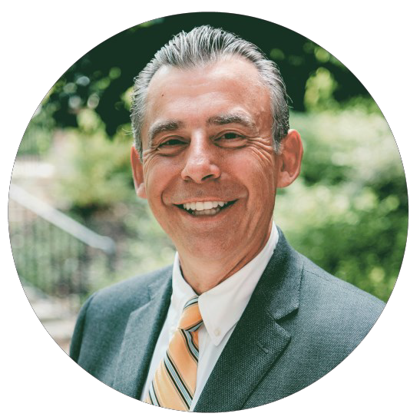


FRIDAY
September 29th
Registration Fee: $189 / Groups of 4 or more $149
9:00 am - 3:00 pm (lunch included) Courtyard by Marriott
3301 Lemone Industrial Blvd. Columbia, MO 65201
Each Participant Will Receive: Your First Year: How to Survive and Thrive as a New Teacher.
In this exciting workshop, internationally renowned educator Todd Whitaker teams up with his daughters - Madeline, an elementary teachers, and Katherine, a secondary teacher - to share advice and inspiration. All are coauthors of the book, Your First Year! They offer step-by-step guidance for thriving in your first few years of teaching and overcoming the challenges that many new teachers face.
Dr. Todd Whitaker is a Distinguished Adjunct Professor at the University of Missouri-Columbia in the Educational Leadership and Policy Analysis department. Dr. Whitaker’s message about the importance of teaching has resonated with hundreds of thousands of educators around the world. He is one of the nation’s leading authorities on staff motivation, teacher leadership, and principal effectiveness.
Dr. Whitaker has written over 50 books.
Topics include:
Developing specific language for communicating with parents
Learning how to establish classroom management skills
Setting up the classroom and establishing procedures and rules
Planning effective lessons
Managing your own emotions in the classroom and dealing effectively with misbehavior
Working with peers, administrators, and parents to build support systems and foster collaboration
Opportunity to collaborate and connect with peers
Register Today! maesp.com/Great-New-Teachers For more information contact maesp@maesp.com

Slide 19






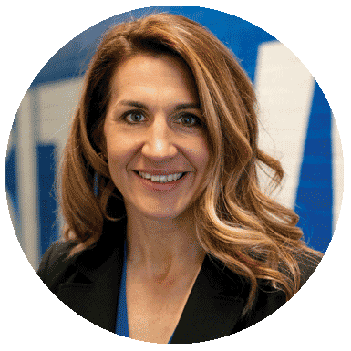

Registration Fee: $189
9:00 am - 3:00 pm (lunch included) MAESP Office
3550 Amazonas Drive Jefferson City, MO 65109
In recent years, the importance of early childhood education has gained widespread recognition, as we understand the profound impact it has on a child's overall development. Research has shown that the early years of a child's life are crucial for building the foundation of their cognitive, social, emotional, and physical growth. Hence, integrating effective pre-kindergarten programs within schools is vital in nurturing well-rounded individuals who are better prepared for academic success and lifelong learning.
Director of Early Childhood and
Parents As Teachers Springfield Public Schools
At the heart of this endeavor stands a key figure, the school leader, who plays an instrumental role in shaping and supporting pre-kindergarten efforts within their schools. The leader’s support, vision, and dedication are pivotal in creating an environment that fosters early childhood development.
Early Childhood expansion has impacted the elementary leader’s scope of work. Join the conversation with school leaders on how to include and improve early childhood programs in your building.
Topics include:
Executive Director, Special Programs North Kansas City Schools
Kindergarten Readiness - What does this mean?
Can Early Childhood be rigorous?
MTSS and the e-DECA - for Pre-K
Transition from Pre-K to Kindergarten
Ways to succeed as a Pre-K Leader: Try this, not that
Register Today! maesp.com/Embracing-Early-Childhood For more information contact maesp@maesp.com

Slide 20
Notice to MAESP Officer Candidates
According to the MAESP by-laws, anyone wishing to run for office shall:
Those persons wishing to become a candidate for the office of president-elect or vice president must be in a fourth (4) consecutive year (or more) as an active member of MAESP.
Those persons wishing to become a candidate for the office of NAESP Representative must be a practicing elementary or middle level principal in their sixth (6) consecutive year (or more) as an active member of MAESP. They must also be an active member of NAESP.
Have paid annual dues before December 1, 2023.
Have filed for a specific office by December 1 by notifying the MAESP Executive Director in writing of his/her intent to become a candidate. Written notification must be postmarked on or before December 1, 2023.
Send a resume of professional activities (not to exceed 200 words in length) and a head and shoulders photo to the MAESP office by December 1, 2023.
If you have any questions about the duties or guidelines, please view the MAESP Constitution and By-Laws. Article VII in the Constitution outlines the duties of the officers and Article IV in the ByLaws outlines the procedures for the election of officers.
Revised 9/13/2021

Slide 21
2024 MAESP Leadership Conference
Margaritaville Lake Resort at Tan-Tar-A Conference Center - Osage Beach, MO
March 2-5, 2024
Call for Workshop Proposals
MAESP is currently looking for workshop presenters for the 2024 MAESP Leadership Conference for elementary and middle-level leaders, March 2-5, 2024 at Margaritaville Lake Resort at
Tan-Tar-A Conference Center in Osage Beach, MO.
Come join the best of your colleagues and celebrate the principalship with MAESP. Your knowledge, experiences, expertise and best practices are needed to help shape a top-notch professional experience for hundreds of pre-K, elementary and middle-level leaders attending from across the state.
Topics principals tell us they want to learn about include:
Leadership, Teacher Evaluation, Principal Evaluation, Data & Assessment, Instructional Coaching and Feedback, Teacher Quality and Effectiveness, Behavior Management, Technology in Schools, School Culture, Celebration and Appreciation, Innovative School Practices, Effective Grant Writing, School Safety and Security, Standards-based Grading, Using Social Media, Engaging Parents and the Community, Common Assessments, Technology for Principals, Being a Change Agent, Dealing with Mental Health Issues, Artificial Intelligence (AI), Effective Scheduling, Communication Strategies, Running an Effective Faculty Meeting, Health and Wellness, Building a Team, Managing the First Year as Principal.
Deadline: October 13, 2023
Submit online at maesp.com/Presenter-Proposal.
Register For the Conference Now!
Early Bird Registration Ends December 1, 2023

Slide 22
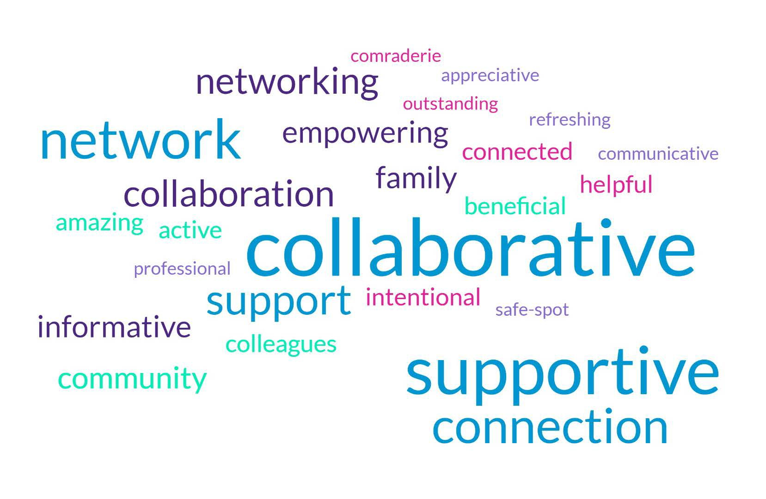
What’s the one word you would use to best
describe our associa�on (MAESP)?
Frequency | Word
11 | collaborative
9 | supportive
7 | network
6 | connection
5 | support
4 | collaboration, networking
3 | informative, family, empowering, community
2 | colleagues, active, amazing, beneficial, connected, intentional, helpful
1 | camaraderie, outstanding, appreciative, professional, safe-spot, refreshing, communicative, distance, teamwork, necessary, proactive, relationships, social, valuable, dedicated, advocates, comprehensive, kind, available, quality, passionate, administrative, limited, PD, resource, educational, driven, inspiring

Slide 23
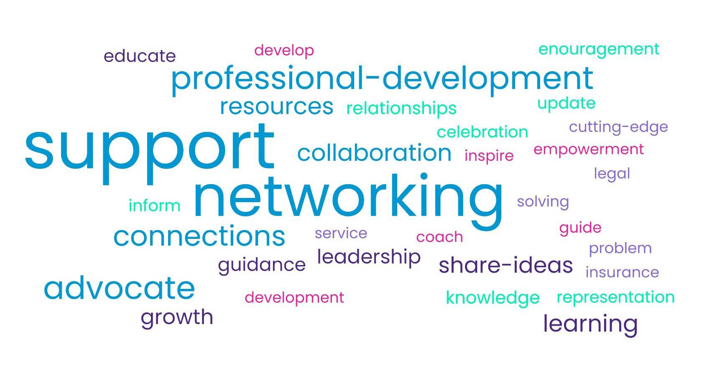
In your opinion, what is the primary role of MAESP?
Frequency | Word
43 | support
36 | networking
15 | advocate, professional development
12 | connections, resources, collaboration, learning
8 | learning
7 | share ideas
6 | growth
5 | leadership
4 | guidance
3 | educate, knowledge, relationships
2 | celebration, encouragement, inform, representation, update
1 | coach, develop, development, empowerment, guide, inspire, insurance, legal, problem-solving, cutting-edge, service

Slide 24
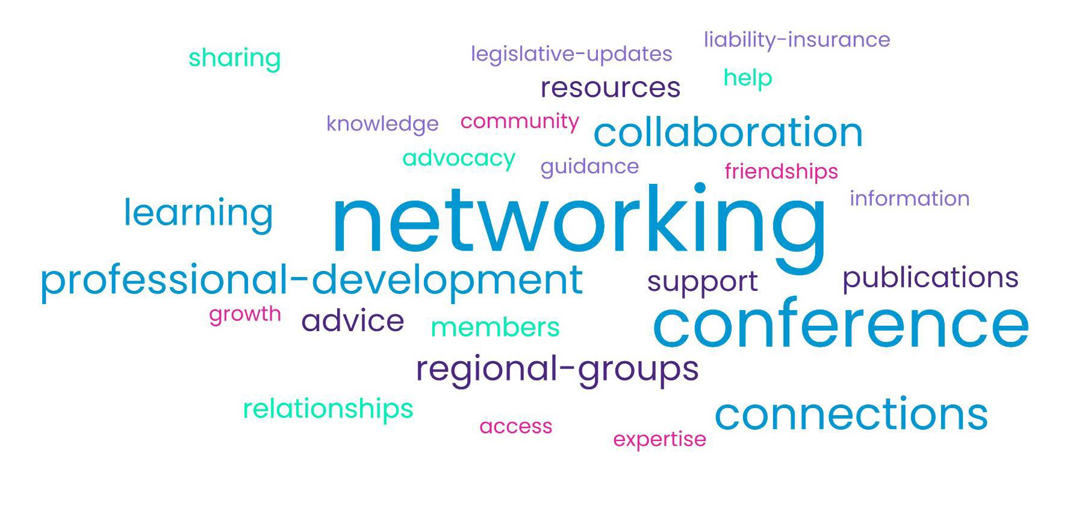
As a school administrator, what part of MAESP is most valuable to you?
Frequency | Word
36 | networking
24 | conference
13 | connections
11 | collaboration, professional development
9 | learning
8 | regional groups
6 | advice
5 | publications, resources
5 | resources
4 | members, relationships
3 | sharing
2 | advocacy, help
1 | access, community, expertise, friendships, growth, guidance, information, knowledge, legislative updates, liability insurance,

Slide 25
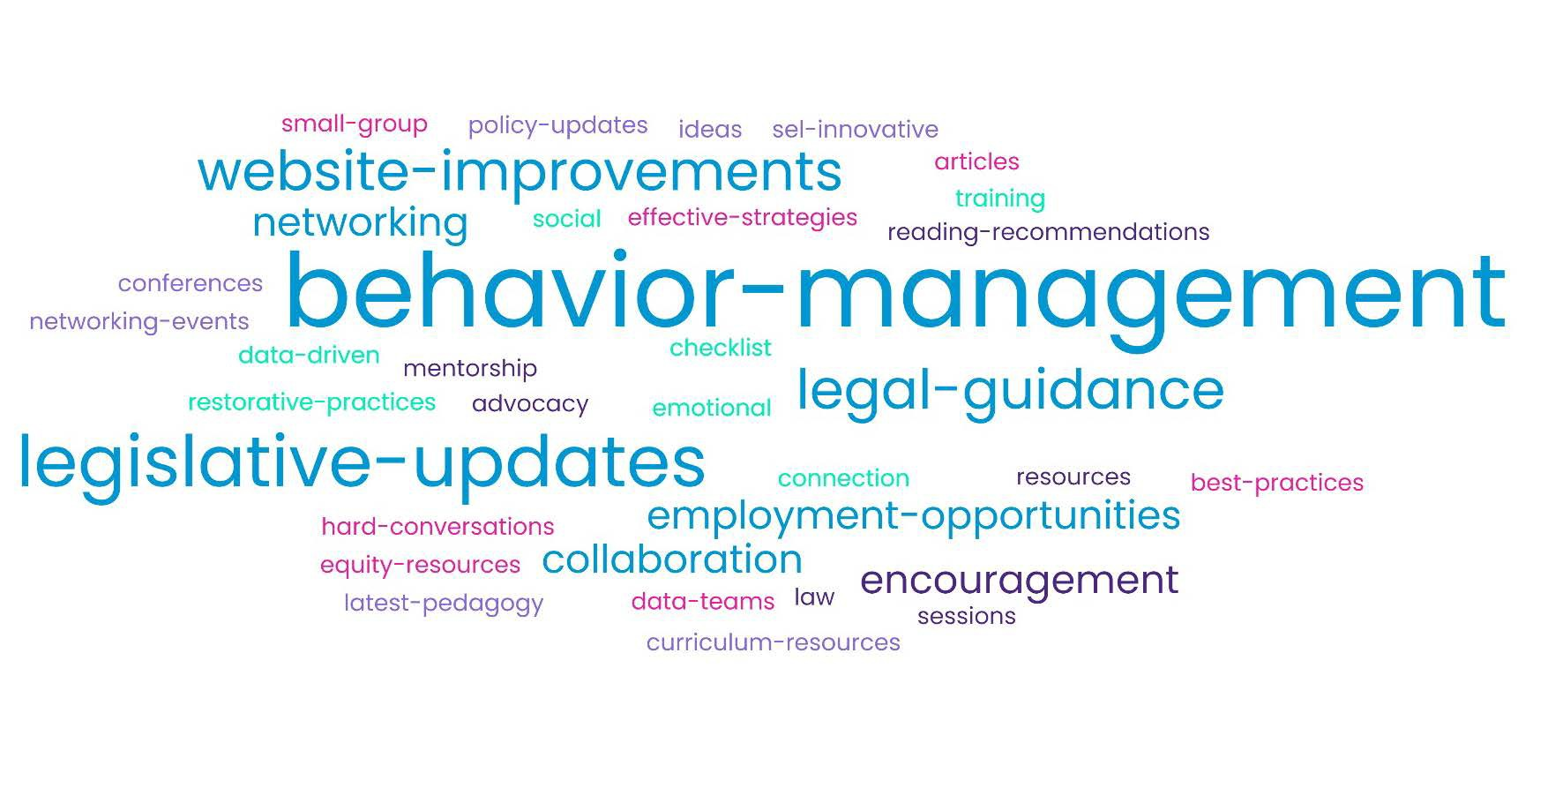
Are there any speciﬁc resources you ﬁnd yourself in need of?
Frequency | Word
6 | behavior management
4 | legislative updates
3 | website improvements, legal guidance
2 | networking, collaboration, employment opportunities, encouragement
1 | law sessions, resources, advocacy, mentorship, reading recommendations, social-emotional restorative practices, training, principal checklist, connections, data-driven small group best practices, equity resources, data teams, effective strategies, hard conversations, articles, latest pedagogy, SEL innovative ideas, policy updates, curriculum resources, conferences, networking events, balancing roles as a principal, differentiation for different types of schools, RPDC connections, aspiring principal learning opportunities, motivating students, parent involvement, information from DESE, website forum, supporting new staff, talent recruitment

Slide 26
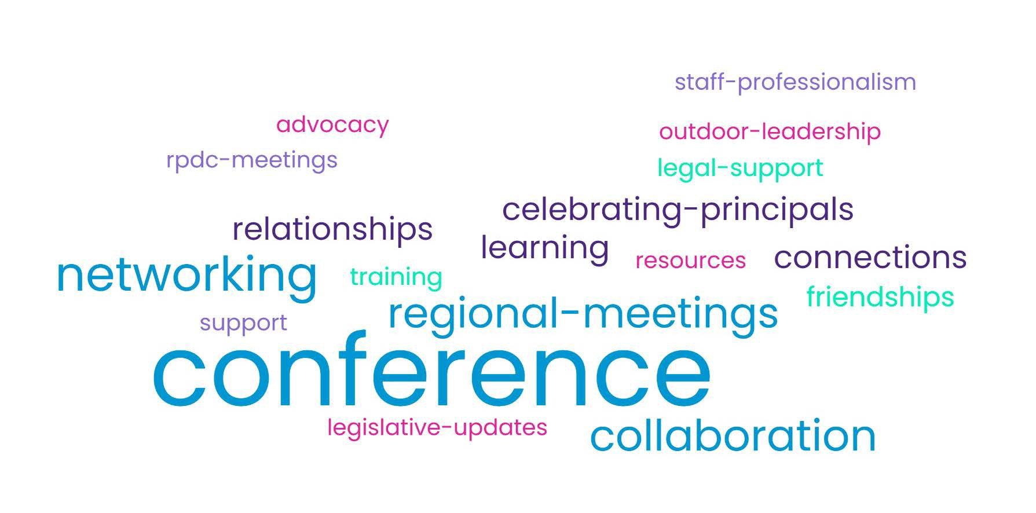
Over the years, what’s the most valuable experience you have had as a member of MAESP?
Frequency | Word
53 | conference
18 | networking
15 | collaboration
14 | regional meetings
7 | celebrating principals, connections, learning, relationships
4 | friendships
2 | legal support, training
2 | training
1 | advocacy, legislative updates, outdoor leadership, resources, RPDC meetings, staff professionalism, support

Slide 27
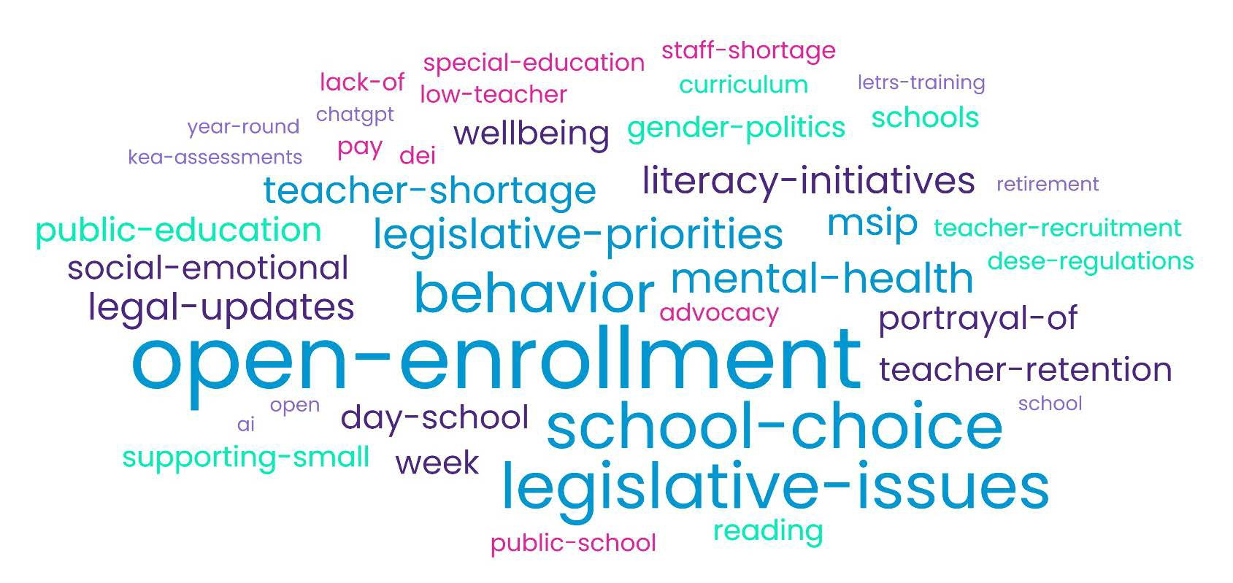
Moving forward, are there any trends in educa�on that you hope MAESP is keeping their eye on?
Frequency | Word
16 | open enrollment
11 | school choice, legislative issues
9 | behavior
6 | mental health, legislative priorities
5 | teacher shortage, MSIP 6, literacy initiatives, legal updates
4 | 4 Day School Week, Teacher Retention, Social-Emotional Wellbeing, Portrayal of Public Education
3 | reading, Gender Politics, Supporting Small Schools
2 | Teacher Recruitment, DESE Regulations, Curriculum, low teacher pay, public school advocacy, special education, staff shortage, lack of support, DEI
1 | chatgpt, OPEN AI, LETRS Training, KEA Assessments, Retirement, Year Round School, Attendance Requirements, Alternative Certification, School Consolidation, Parent Rights, Retirement Protection, Early Literacy, Instruction, Virtual Instruction, Parental responsibilities, Parent Bill of Rights, Technology, Care for Administrators, Sub Shortage, Enrollment, Mentorship, Women in Leadership, MTSS, Standards Based Grading, Equity, Diversity, Tier 1 Instruction, Technology Affects on the Brain, Teacher Contracts, DESE News, Cognitive Science, Personalized learning, Supporting Students and Families experiencing Trauma, Teacher Certification, Data Tracking, School Violence, Students with Disabilities, Priority for Early Education, Lack of Interventions

Slide 28
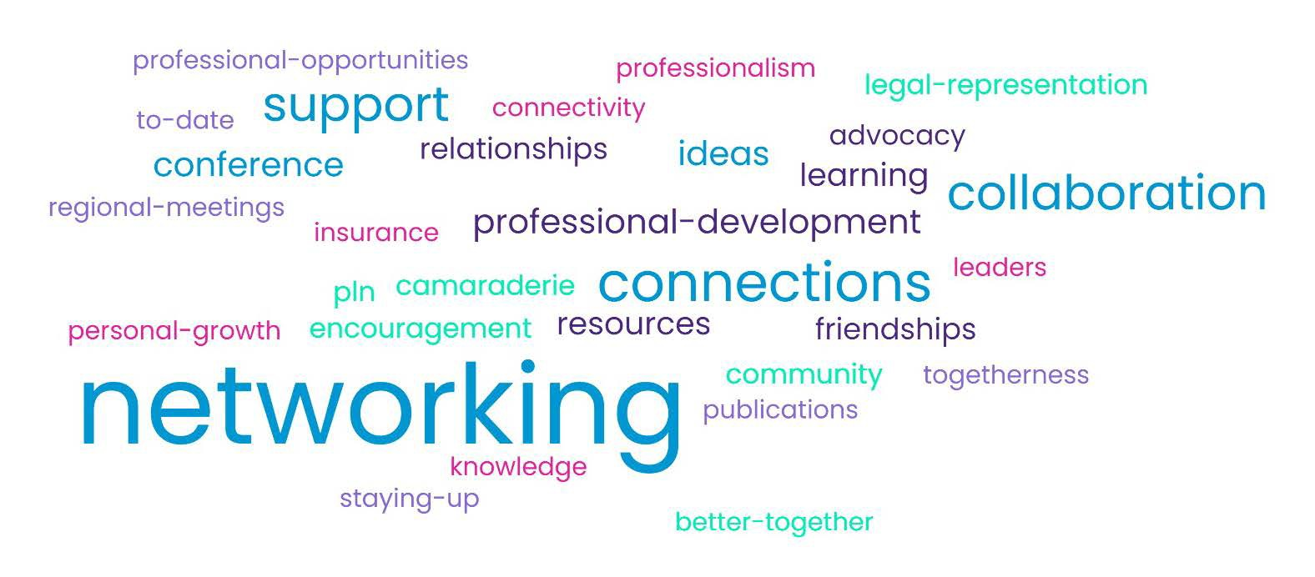
What is one reason you would give a fellow administrator to join MAESP?
Frequency | Word
42 | networking
15 | connections
12 | collaboration, support
5 | conference, ideas, professional development
4 | learning, resources
3 | friendships, relationships
2 | advocacy, camaraderie, community, encouragement, legal representation, PLN
1 | better together, connectivity, insurance, knowledge, leaders, personal growth, professionalism, professional opportunities, publications, regional meetings, staying up to date, togetherness

Slide 29
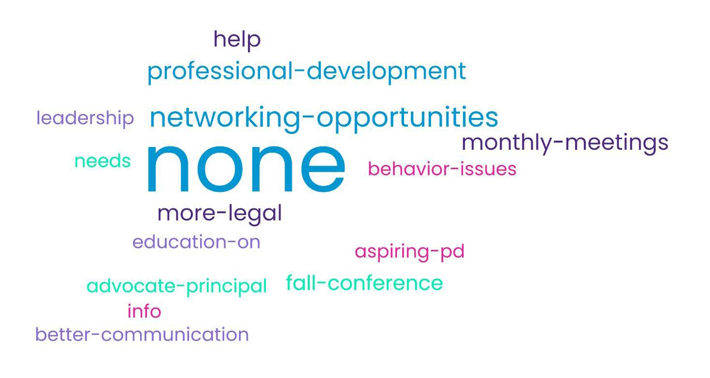
Do you have any thoughts on how we could
beter serve our members?
Frequency | Word
36 | none
6 | more networking opportunities
4 | more professional development
3 | monthly meetings
3 | more legal support
2 | fall conference
1 | advocate the importance of MAESP to superintendents/BOE, more PD for aspiring principals, more information on MAESP regional leadership, more information on dealing with behavior issues, better communication, more information on how to get involved in MAESP, newsletter that can be accessed without logging in, regular zoom calls/PD opportunities, website improvements, better training for regional leaders, continued regional meeting visits by Executive Director, PD opportunities in other locations around the state, literature outreach, more insurance, more information on NAESP, requirement to join NAESP to be eligible for awards, create overlap with MLDS program through RPDCs

Slide 30
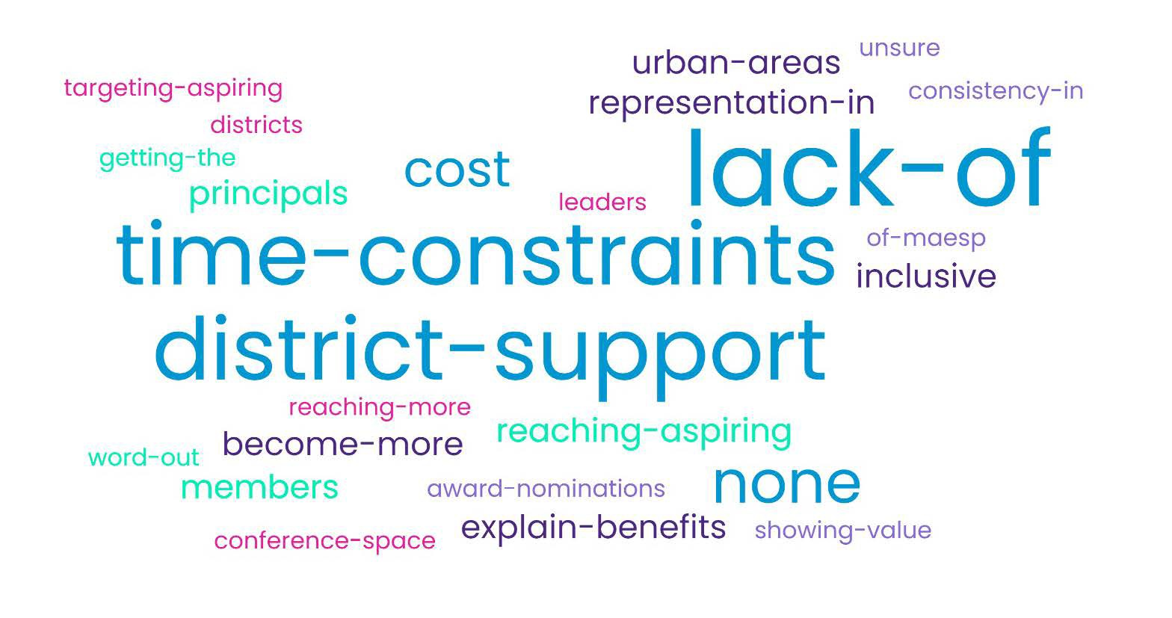
What barriers do we need to overcome as we look to add new members?
Frequency | Word
10 | lack of district support
8 | time-constraints
5 | none
5 | cost
3 | find ways to reach aspiring principals
2 | representation in urban areas, explain benefits of joining, become more inclusive, find ways to reach aspiring principals
1 | getting the word out, reaching more district, conference space, showing value of joining, consistency in award nomination process across all regions, legal support, administrators are leaving the profession, leadership politics, expand offerings to different locations, giving smaller districts a voice, region geographically too large, more virtual meeting options, create regional membership lists, empower regional leaders to recruit new members, advertising methods, social media and high stress, continue valuable PD offering, admin mental health, other associations, making new members feel welcome, keeping track of changing admins, creating mentorships through RPDC, reaching all members in all locations

